Slide 1
Security in Distributed Systems
By: Derrick Murphy

Slide 2
What is a Distributed System
A Distributed System is:
a collection of autonomous computers connected users perceive as a single system
Connected through a network and distribution middleware, which enables computers to coordinate their activities and to share the resources of the system

Slide 3
Examples of Distributed Systems
The world wide web
Global access to everybody
No single authority
Enormous size
Open ended
Communication Types:
Interrogation, announcement, stream
Data, audio, video
Intranets
An intranet is a private network that is contained within an enterprise
A single authority
Protected access
Typical services:
File service, name service, application services

Slide 4
Characteristics of Distributed Systems
Multiple independent components
Components are not shared by all users
Resources may not be accessible
Software runs in concurrent processes on different processors
Multiple Points of control
Multiple Points of failure

Slide 5
Goals
Distribution transparency
Make collection of computers appear as a single computer
Openness
Ability to build and change
Scalability
Systems growth over time or it becomes obsolete
Security
Confidentiality, integrity, availability

Slide 6
Advantages of Distributed Systems
Economics
Speed
Inherent distribution
Reliability
Incremental growth

Slide 7
Disadvantages of Distributed Systems
Software
Network
More components to fail
Security

Slide 8
Security-Driven Fault Tolerant Scheduling Algorithm for High Dependable Distributed Real-Time System
Authors:
Xia Ping
Zhou Xingshe
Improved technique to schedule such tasks with high reliability and security requirement on high dependable
Refined scheduling model which accurately described processors, fault tolerant tasks and security overhead
http://ieeexplore.ieee.org/xpls/icp.jsp?arnumber=6128471

Slide 9
Leading to Security-Driven Fault Tolerant Scheduling Algorithm
Rate-Monotonic (RM)algorithm
which supported preemptively scheduling periodic tasks only on single processor.
Liu and Layland
Rate Monotonic First-Fit (RMFF) algorithm
supported scheduling real time tasks on multiprocessor system.
Dhal and Liu extended the RM algorithm
Fault Tolerant RMFF (FFRMFF) algorithm
introduced fault tolerance technique to RMFF, but it didn’t consider the security requirement of real time tasks and tolerated only one processor failure.
based on RMFF
Alan and Luigi
Novel dynamic scheduling algorithm with security awareness
algorithm didn’t support static scheduling which made it not be adaptive to scheduling large numbers of periodic tasks
didn’t support fault tolerance.
Tao and Qin

Slide 10
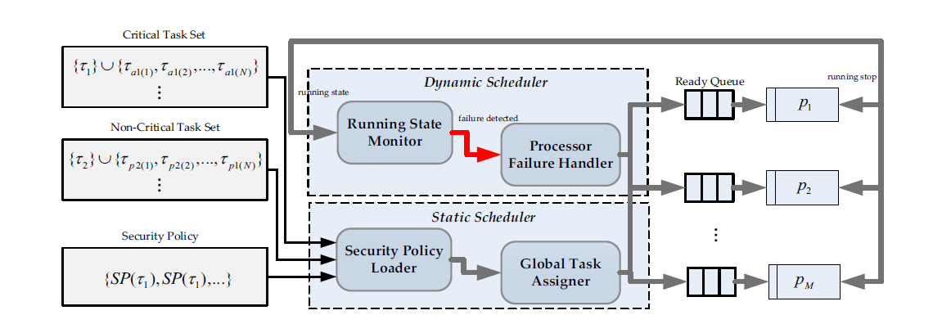
The SDFT Scheduling Algorithm Framework

Slide 11
The SDFT Scheduling Algorithm
Security Driven Fault Tolerant Scheduling Algorithm (SDFT) which extended FTRMFF algorithm to tolerate N processors failure at one time.
Fault-tolerant rate-monotonic first-fit algorithm
Introduced a new global scheduler to improve efficiency of scheduling process
Supported flexible security policy applied on real time tasks according to its security requirement and considered the effect of security overhead during scheduling

Slide 12
The SDFT Scheduling Algorithm
Four core components:
Security Policy Loader
Global Task Assigner
Running State Monitor
Processor Failure Handler
Simulation experiments showed the SDFT algorithm can achieve better reliability and security at the cost of less number of processors.

Slide 13
Access Control Method Based on Multi-level Security Tag for Distributed Database System
Authors:
Ying-Guang Sun
Mandatory access control policy
Mandatory access control is achieved by modifying the user's query statement and using security tag table in distributed database system.
The essential security technologies in the distributed database are:
users' authentication
access control

Slide 14
MULTI-LEVEL SECURITY ACCESS CONTROL POLICY
Distributed database system is consisted of a set of interconnection network server and client.
Objects are divided into different groups with a certain security level
different groups have different security levels.
Information flow among objects with different security levels must meet certain security access control policy.
Bell-LaPadula model
Basis that we design multilevel secure database system
describes the reasonable flow path of information in the security system
defines the system security requirements for processing the data with the different security levels.

Slide 15
Bell-LaPadula model
Introduces concepts of:
Subject
Object
Domain
Subject:
is a user or group of users, every subject was given a security level, and login by this security level.
Object :
is the target which is visited in the system, the object is also given the security level. the level of object follows the object's content, background, time or membership, etc.
Domain:
of subject is the collection of object which subject can access. The domain of object is the collection of the target of object itself.

Slide 16
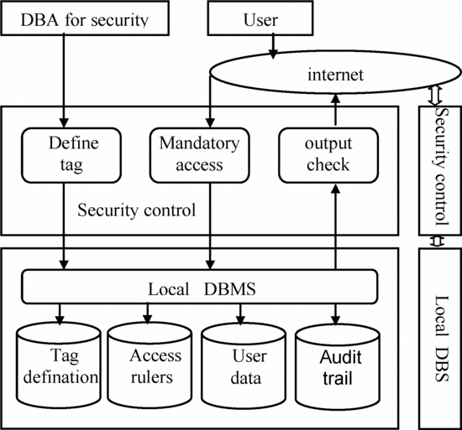
Multi-level security system structure for distributed database

Slide 17
Reference
Kangasharju, Jussi. “Distributed Systems: What Is a Distributed System?” DistSys-08f-1.Pdf, 2008, www.cs.helsinki.fi/u/jakangas/Teaching/DistSys/DistSys-08f-1.pdf
Sun, Ying-Guang. “Access Control Method Based on Multi-Level Security Tag for Distributed Database System.” Semantic Scholar, www.semanticscholar.org/paper/Access-control-method-based-on-multi-level-Sun/273d77cccd34e4589ba0802bff0a6d293cce2cf0.

